Slide 1
Stored GRAIN protection & spoilage alert system

Slide 2
Introduction (Problem Identification):
Grains are vulnerable to Temperature , Humidity , and Harmful Gases .
Grain quality depends on proper storage conditions.
High temperature or humidity can cause spoilage, fungus, and insect growth.
To overcome this, a simple IoT-based alert system is designed using ESP32 and Blynk app
THIRD REVIEW-V.S.B ENGINEERING COLLEGE,KARUR.

Slide 3
Objectives :
To monitor grain storage conditions in real time.
To continuously monitor temperature and humidity of stored grains.
To alert farmer when values exceed safe limits.
To send real-time notification via Blynk app.
To make it cost-effective and partially solar powered.
THIRD REVIEW-V.S.B ENGINEERING COLLEGE,KARUR.

Slide 4
Abstract:
This project focuses on Protecting stored grains using a Hybrid monitoring system , both IoT & offline.
We use an ESP32microcontroller , temperature & humidity sensors to continuously monitor grain storage conditions.
If abnormal conditions like excess moisture or heat formation are detected ,the system sends instant alerts.
This helps from preventing Spoilage and losses.
THIRD REVIEW-V.S.B ENGINEERING COLLEGE,KARUR.

Slide 5
Existing System:
Existing System, Previous systems had advanced prevention methods
Those systems are expensive and power consuming.
Required more components and complex circuitry.
Components may damage sometimes.
THIRD REVIEW-V.S.B ENGINEERING COLLEGE,KARUR.

Slide 6
Proposed System:
Proposed System simple, low-cost solution using ESP32 microcontroller.
DHT22 sensor detects temperature and humidity.
When unsafe level detected.
Buzzer alerts locally.
Blynk app sends mobile notification.
Powered by solar panel for eco-friendly operation
THIRD REVIEW-V.S.B ENGINEERING COLLEGE,KARUR.

Slide 7
Working Principle:
Start the System.
The ESP32 collects data from sensors.
If temperature, humidity, or gas levels go beyond the threshold Triggers buzzer/LED alert.
Compare values with safe range
If safe->Display “All OK”
If unsafe -> Trigger buzzer + IoT Alert.
Farmer/warehouse owner receives an instant notification.
Repeat Continuously.
THIRD REVIEW-V.S.B ENGINEERING COLLEGE,KARUR.

Slide 8
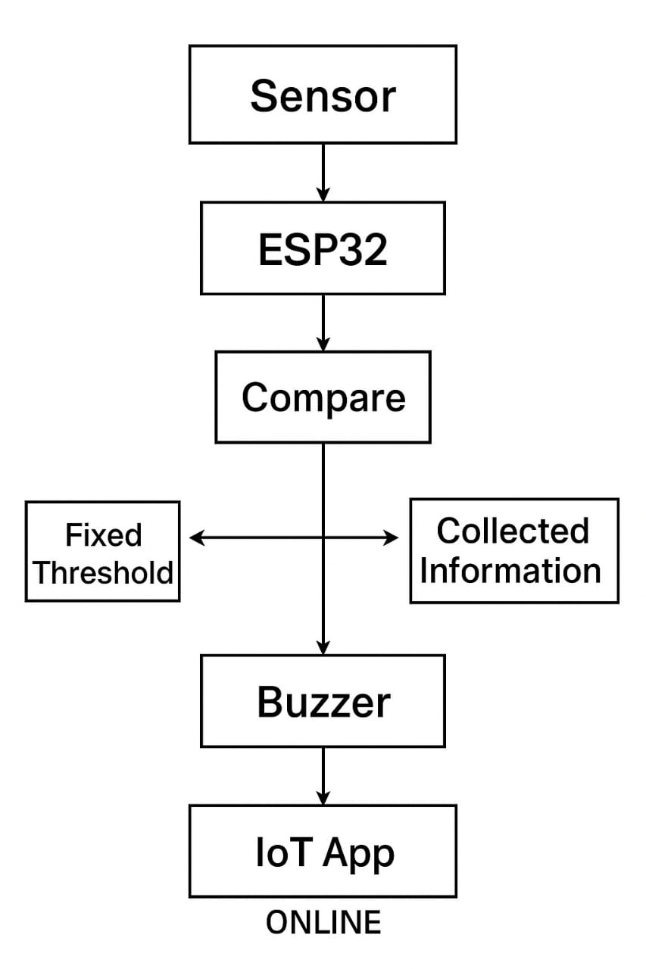
Block Diagram:
THIRD REVIEW-V.S.B ENGINEERING COLLEGE,KARUR.

Slide 9
Components Used:
ESP32 → Main IoT microcontroller(IoT & offline).
DHT22 Sensor → Measures temperature & humidity.
Buzzer / LED → Local alert system.
Buzzer .
Wi-Fi Module (Built-in ESP32) → Cloud connectivity.
Blynk Dashboard → Displays data & alerts.
THIRD REVIEW-V.S.B ENGINEERING COLLEGE,KARUR.

Slide 10
Microcontroller:
The ESP32 receives sensor data (e.g., temperature , humidity ).
Send data to an IoT App or cloud server (like Blynk).
Control connected devices remotely.
Monitor sensor readings online in real time.
It can handle multiple sensors simultaneously using its built-in ADC and GPIO pins.
THIRD REVIEW-V.S.B ENGINEERING COLLEGE,KARUR.

Slide 11
DHT22 Sensor:
Measures temperature and relative humidity.
Provides a digital output , which makes it easy to interface with microcontrollers like ESP32.
Uses a single-wire serial interface to transmit data — simple to connect and requires only one data pin.
Low power consumption, suitable for battery-powered or solar-powered IoT systems.
Accurate and stable.
THIRD REVIEW-V.S.B ENGINEERING COLLEGE,KARUR.

Slide 12
Blynk App:
Blynk is an IoT (Internet of Things) platform that allows you to control, monitor, and visualize data from hardware devices (like ESP32, Arduino, Node MCU, etc.) using a smartphone or web dashboard.
It’s available for Android, iOS, and Web.
The ESP32 collects sensor data → sends it to Blynk Cloud → displayed in Blynk App.
And commands from the app (like turning ON a buzzer) are sent back to the ESP32 through the cloud.
THIRD REVIEW-V.S.B ENGINEERING COLLEGE,KARUR.

Slide 13
Technical Approach:
Data Collection: The DHT22 sensor measures temperature and humidity inside the grain storage.
Data Processing: The ESP32 reads the sensor values and compares them with safe limits.
Alert System: If values are unsafe, the buzzer rings and an alert message is sent to the Blynk App.
Power Supply: The system runs on solar energy, ensuring continuous and eco-friendly operation.
THIRD REVIEW-V.S.B ENGINEERING COLLEGE,KARUR.

Slide 14
Viability and Feasibility:
Low-cost components; reduces loss and saves money.
Hardware and software easily integrated; solar-powered for reliability.
Technically, economically, and socially sustainable solution for grain preservation.
Easy to use, automatic operation, minimal training.
Eco-friendly and energy-efficient using solar power
THIRD REVIEW-V.S.B ENGINEERING COLLEGE,KARUR.

Slide 15
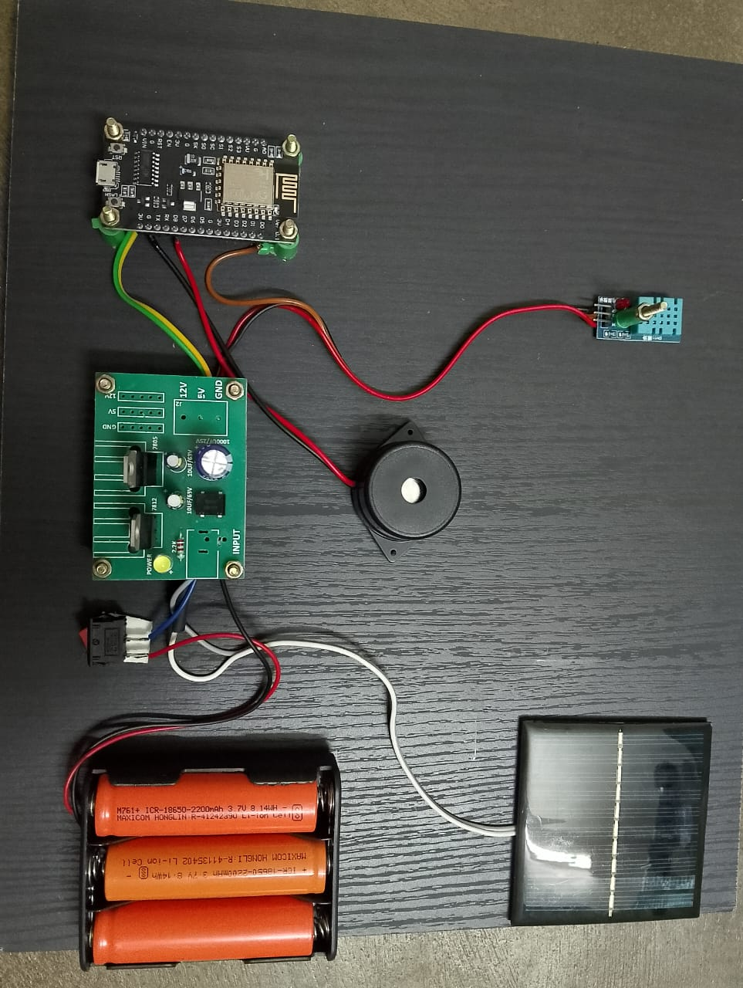
Prototype:
THIRD REVIEW-V.S.B ENGINEERING COLLEGE,KARUR

Slide 16
Reference:
Ajisegiri , E. A. (2025). "Development of a Smart Grain Storage Silo Using the Internet of Things (IoT) Technology.“
Wanyonyi, E. N. (2025). "A Smart IoT-Based Real-Time System for Monitoring Storage Conditions of Maize Grains.“
Lydia, J. (2022). "Automated food grain monitoring system for warehouse storage."
THIRD REVIEW-V.S.B ENGINEERING COLLEGE,KARUR.

Slide 17
Advantages:
Real-time grain monitoring.
Automatic alerts & notifications.
Prevents grain spoilage & reduces losses.
Simple and low-cost compared to earlier models.
No manual checking required.
Energy-efficient (uses solar power).
Easy to install and scalable.
THIRD REVIEW-V.S.B ENGINEERING COLLEGE,KARUR.

Slide 18
Applications:
System successfully detects environmental changes.
Sends immediate alerts via buzzer and mobile notification.
Provides an efficient, affordable alternative to costly automation systems.
THIRD REVIEW-V.S.B ENGINEERING COLLEGE,KARUR.

Slide 19
Any Queries?
THIRD REVIEW-V.S.B ENGINEERING COLLEGE,KARUR.

Slide 20
Thank you!!
THIRD REVIEW-V.S.B ENGINEERING COLLEGE,KARUR.

